Slide 1
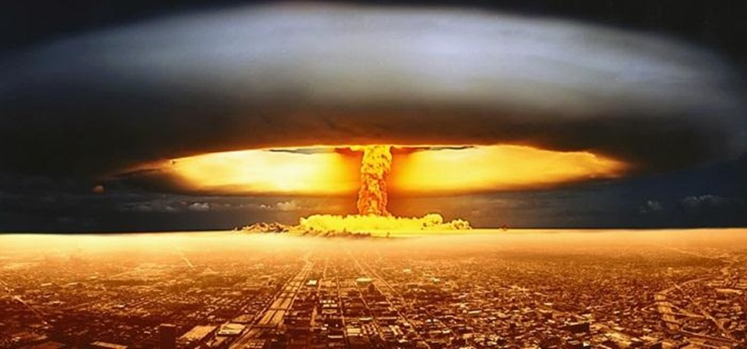
Nuclear Accidents and Holocaust

Slide 2
Nuclear Accidents
Types of Accidents
Nuclear Test.
Nuclear power plant accidents.
Improper disposal of radioactive waste.
Accidents during transport.
Core melt down.

Slide 3
Effects of Nuclear Radiation.
It breaks the chemical bonds of DNA infected DNA Carries to future generations.
Exposure to low dose of radiation ( 100 – 200 rads) results in fatigue, vomiting and loss of hair.
Exposure at higher dose of radiation ( 400 – 500 rads) affects the bone marrow, blood cells, natural resistance and blood to fail to clot.

Slide 4
Effects of Nuclear Radiation.
Exposure to very high ( more than 10000 rads) kills the organisms by damaging the tissues of heart, brain.

Slide 5
Nuclear Holocaust
It means destruction of biodiversity by nuclear equipments and nuclear bombs.
In a holocaust a large number of living beings are totally destroyed.
It happens in nuclear war.

Slide 6
Effect of Nuclear Holocaust
Nuclear winter.
Change of climate due to ashes.
Opposite to Global Warming.
Effects of Nuclear Winter.
Sudden Temperature drop even summer has a freezing point temperature.
Crop productivity is reduced due to lack of sun light.

Slide 7
Effect of Nuclear Holocaust
Examples
Nuclear war
Japan
At Chernobyl
Power plant in Ukrine
31 death at a time.
2000 people has possibility of cancer.
Loss of biodiversity

Slide 8
Control Measures
Enhanced methods to handle the materials with precaution.
Constant monitoring of exposures to radiation level of workers.
Regular checks and control measures are done by Atomic Energy Regulatory Board under the Department of Atomic Energy.

